Slide 1

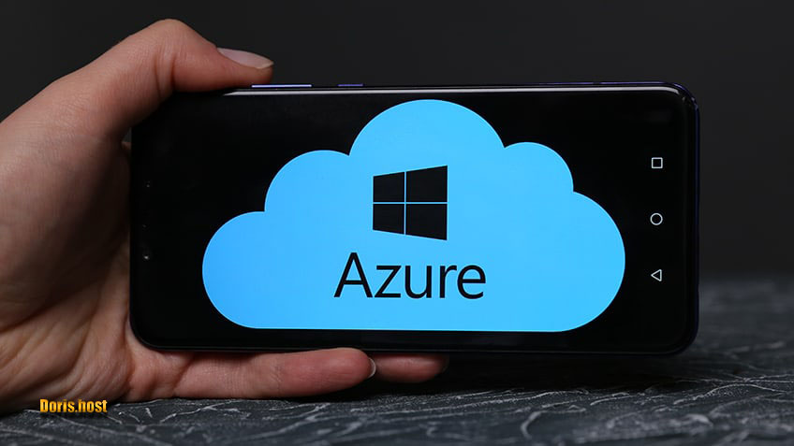
Azure Data studio
Author : Shervin Khalili
Email:
Teacher : Dr Majid Vafayi Jahan
Shervin.khalili@outlook.com
December 2021

Slide 2
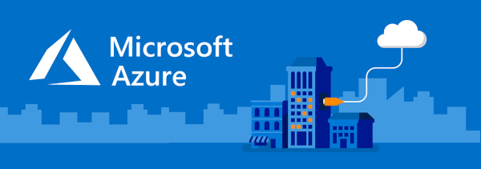
Contents
Azure Data studio
Azure History---------------------------------------------------------------------------3
What you should know----------------------------------------------------------------4
What is the Azure Data studio ?-----------------------------------------------------5
What about SQL Sever Management Studio---------------------------------------6
Reference------------------------------------------------------------------------------8

Slide 3
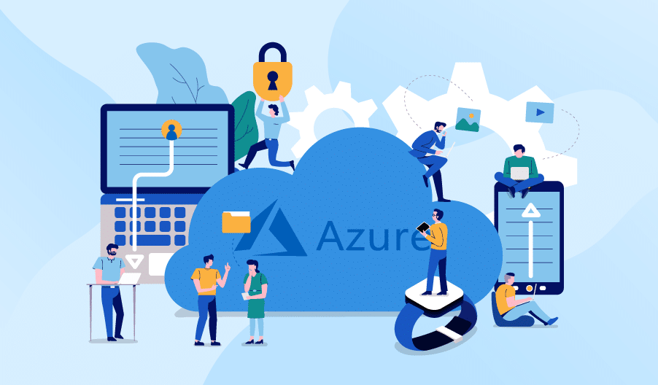
Azure History
Azure Data studio
Windows Azure/Microsoft Azure
Version 1/0 relasend September 2008
Formerly known as SQL Operation Studio
Page 3

Slide 4
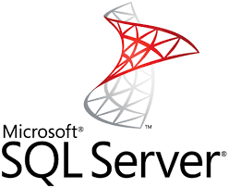


What you should Know
Azure Data studio
Overview understanding of SQL Server
Basics of the Transact – SQL language
Review Learning Microsoft SQL server 2017 or SQL server 2019 if you need an introduction
Docker
Page 4

Slide 5
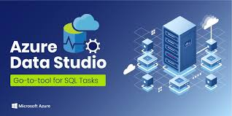
What is Azure Data Studio?
Azure Data studio
Modern, cross-platform database management tool
Connects to Microsoft SQL Server and Azure SQL Database
Interact with server objects
Write SQL queries and send management commands
Review and edit data
Monitor the health of the database
Page 5

Slide 6
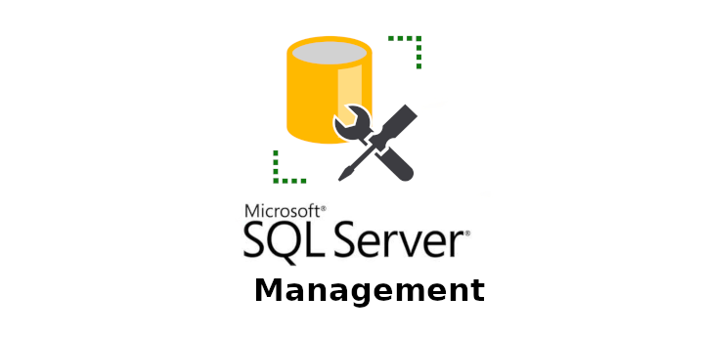
What about SQL Server Management Studio
Azure Data studio
Class –Platform
Supports Windows
Same experience across operating system
Integrated code editor
A primary focus in the development of Azure Data studio
Syntax highlighting,IntelliSence,keyword suggestions, keyboard navigation, and source control with Git
T-SQL code snippets
Page 6

Slide 7
What about SQL Server Management Studio
Azure Data studio
Customization and Extensibility
Build custom database dashboards
Add features with the extension marketplace
Page 7

Slide 8
Reference
Azure Data studio
https://docs.microsoft.com/
https://www.youtube.com
http://saamtech.ir/
https://virgool.io/
Page 8

Slide 9
